Slide 1
SQL Server Management Studio

Slide 2
Choosing The server
In the next slide , in server type choose Database Engine
In Server Name field you need to enter: “yourpcname/instance name”
Instance name I mentioned in the SQL Server slides that you need to save the name of the instance.

Slide 3
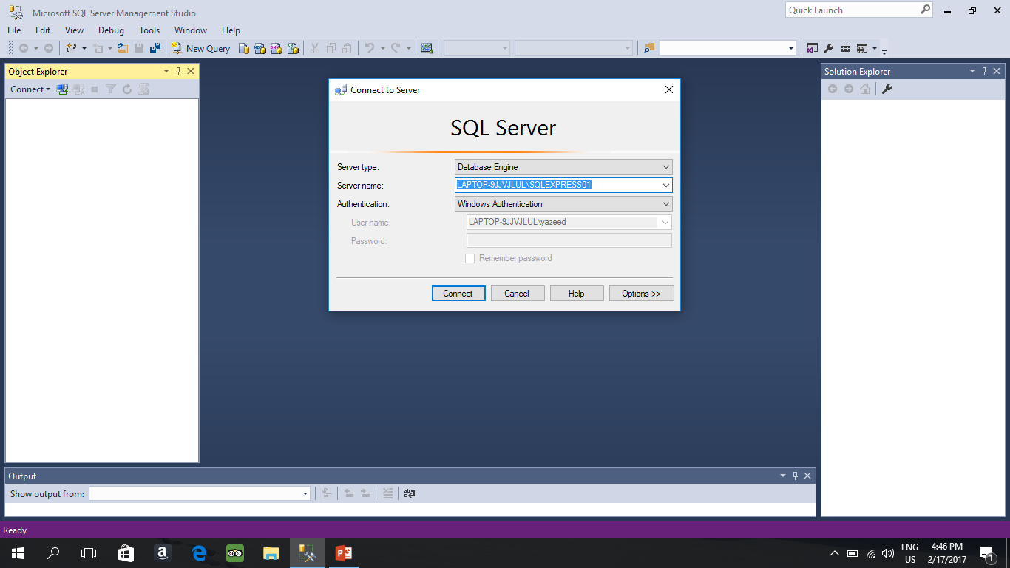
This is the window of SQL MANAGEMENT STUDIO.
PC name
This is my instance name

Slide 4
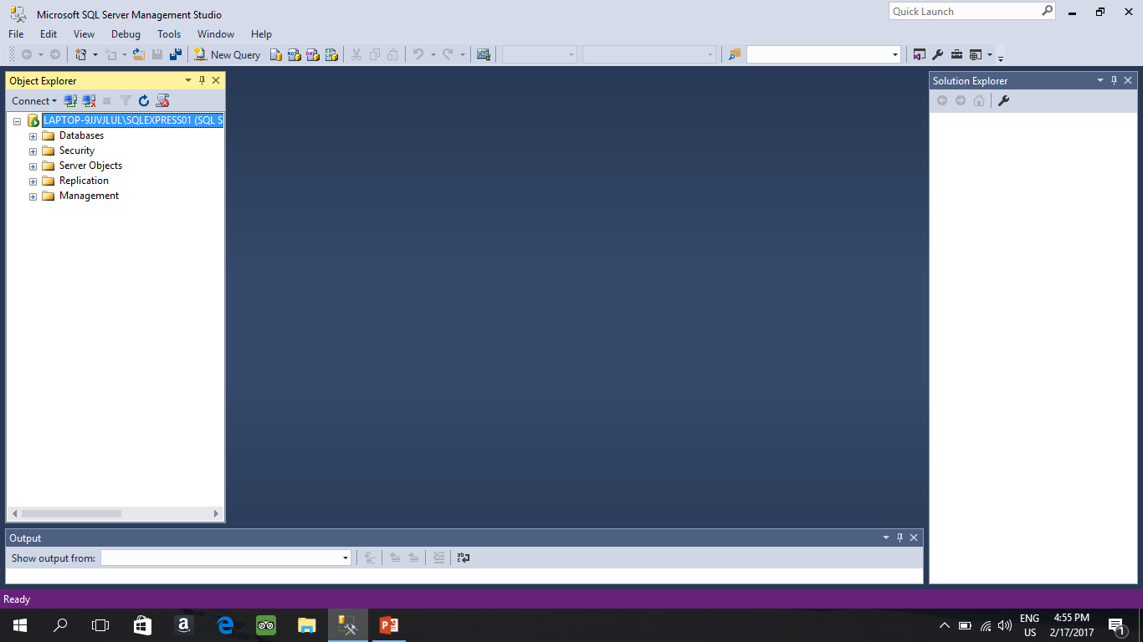
This is your Database local server

Slide 5
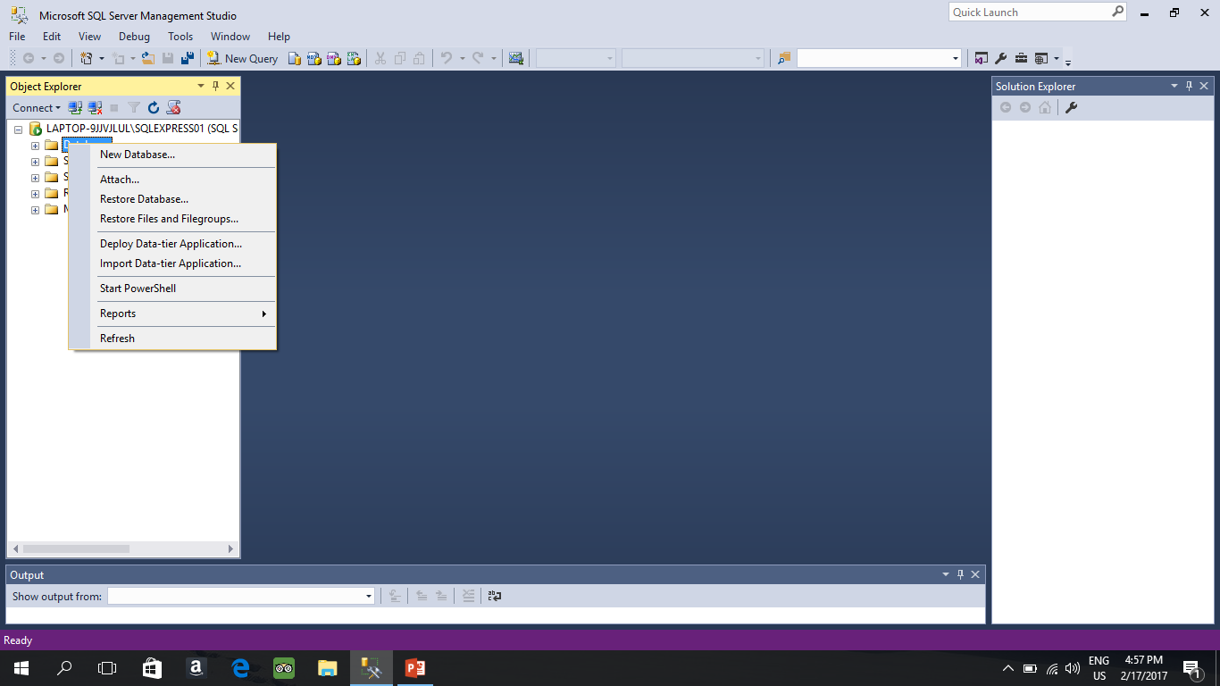
Now you need to add A “Database” on Database folder right click on it and click on new Database

Slide 6
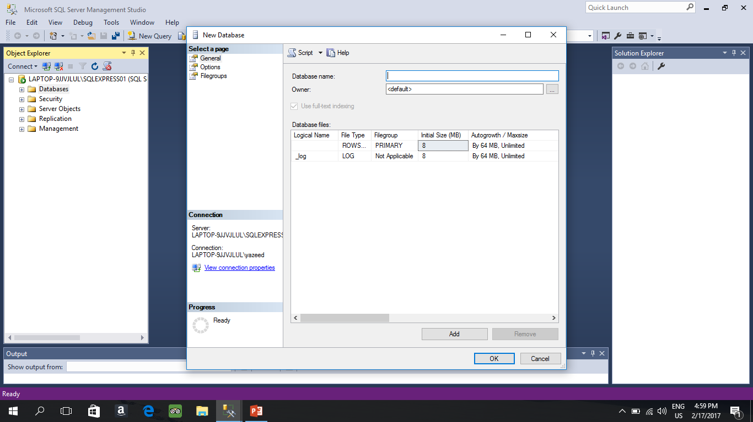
Cont
Give it a name
Then click ok

Slide 7
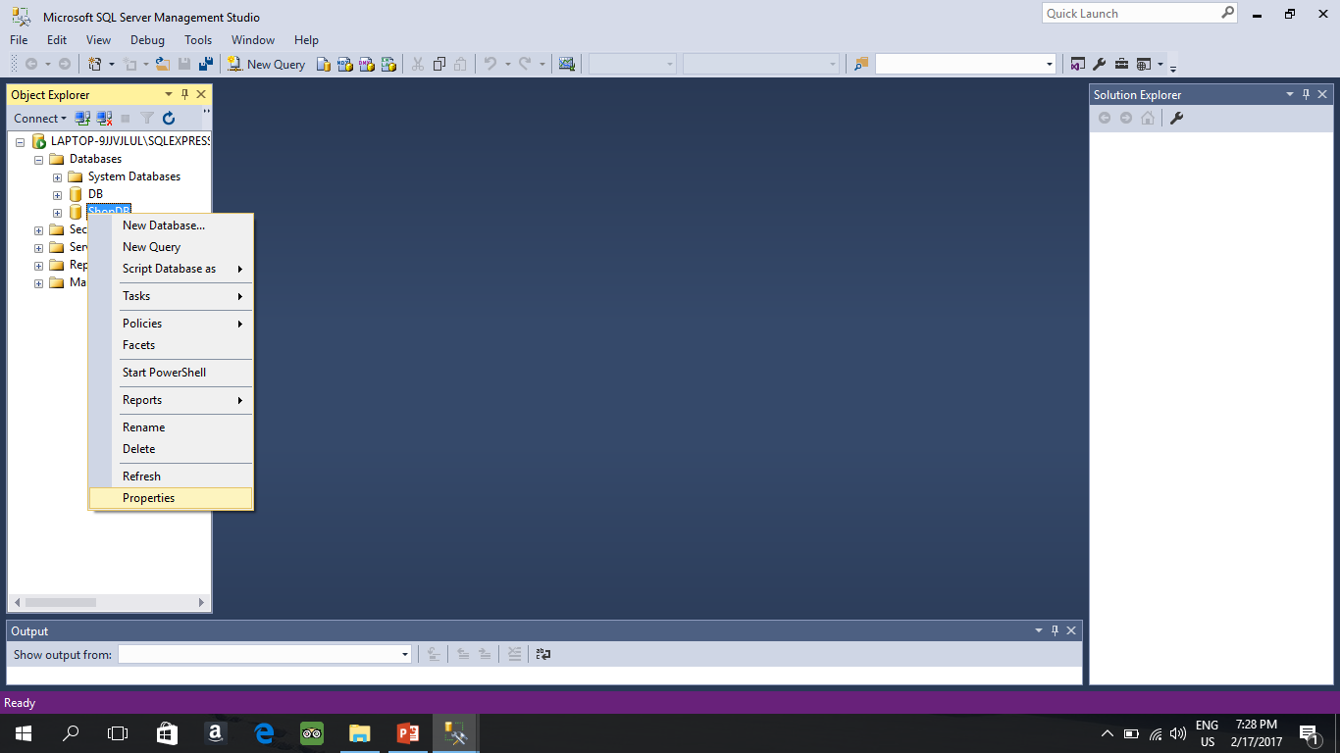
Go to your newly created DB and right click then properties

Slide 8
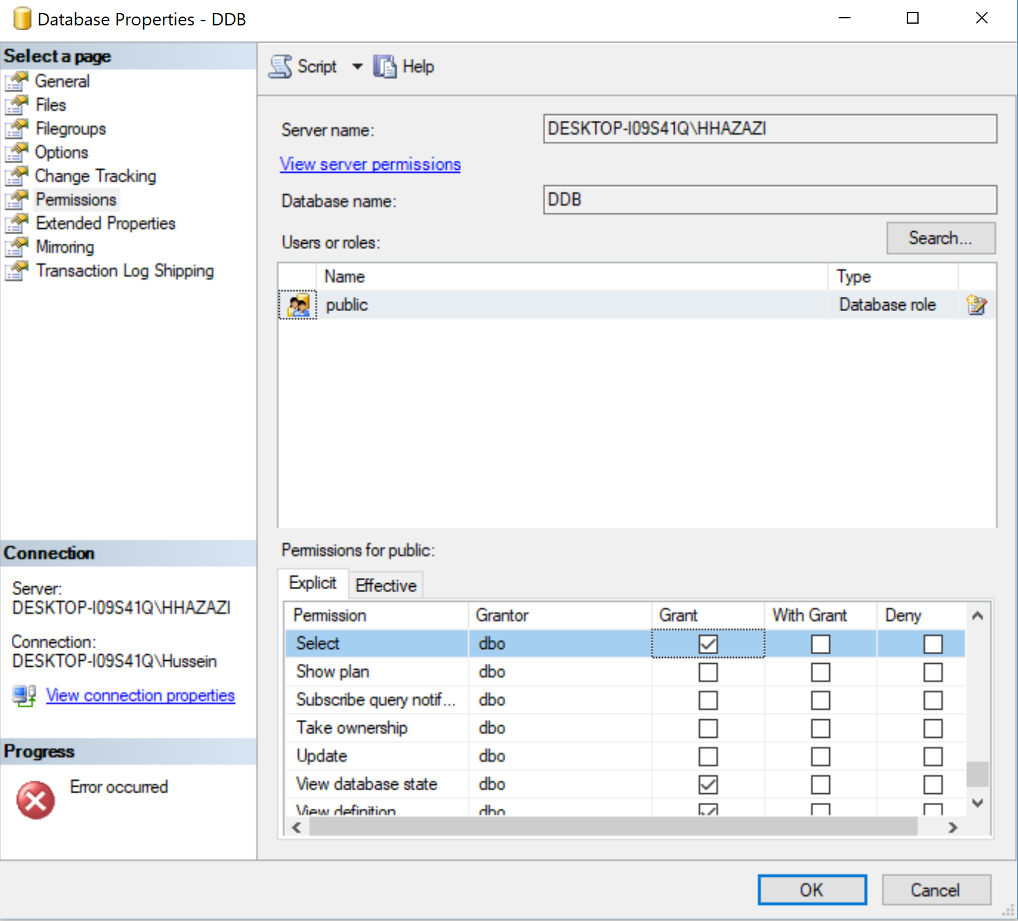
In permissions make sure the public exists and have the below permissions

Slide 9
Operations that you need to know
1.How To Add Table
2.How to set column as primary key
3.How to create a foreign key
4.How to insert Data

Slide 10
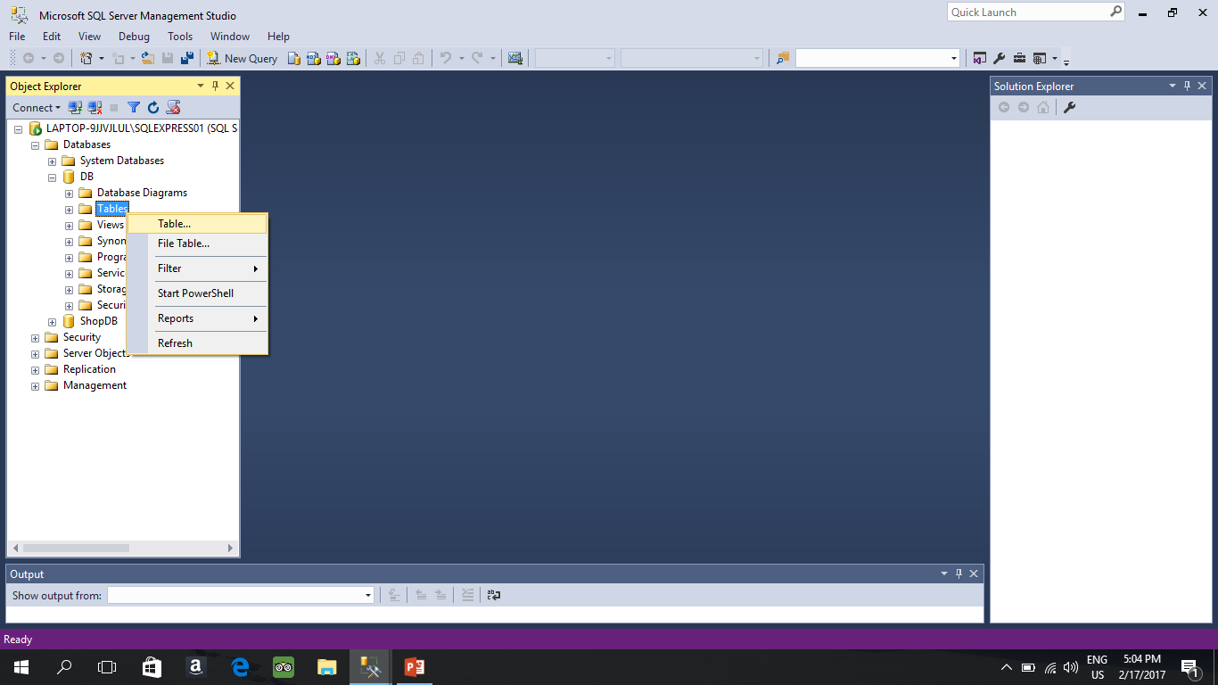
Adding Table

Slide 11
Setting a column as primary key
In our case ID Must be incremented automatically , so we need a little bit of modifications

Slide 12
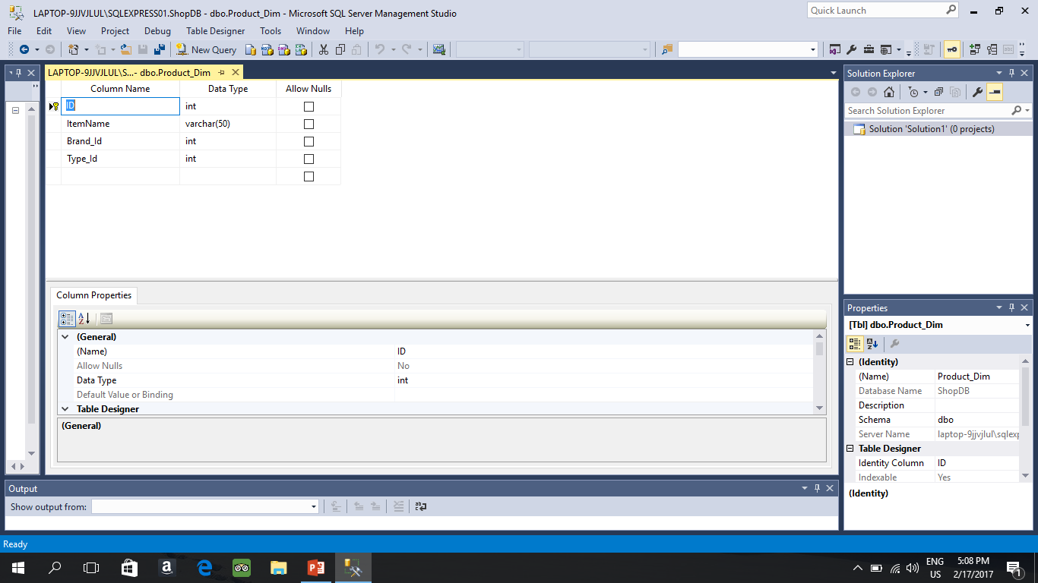
Setting ID as primary key : Click on the column then press this key sign

Slide 13
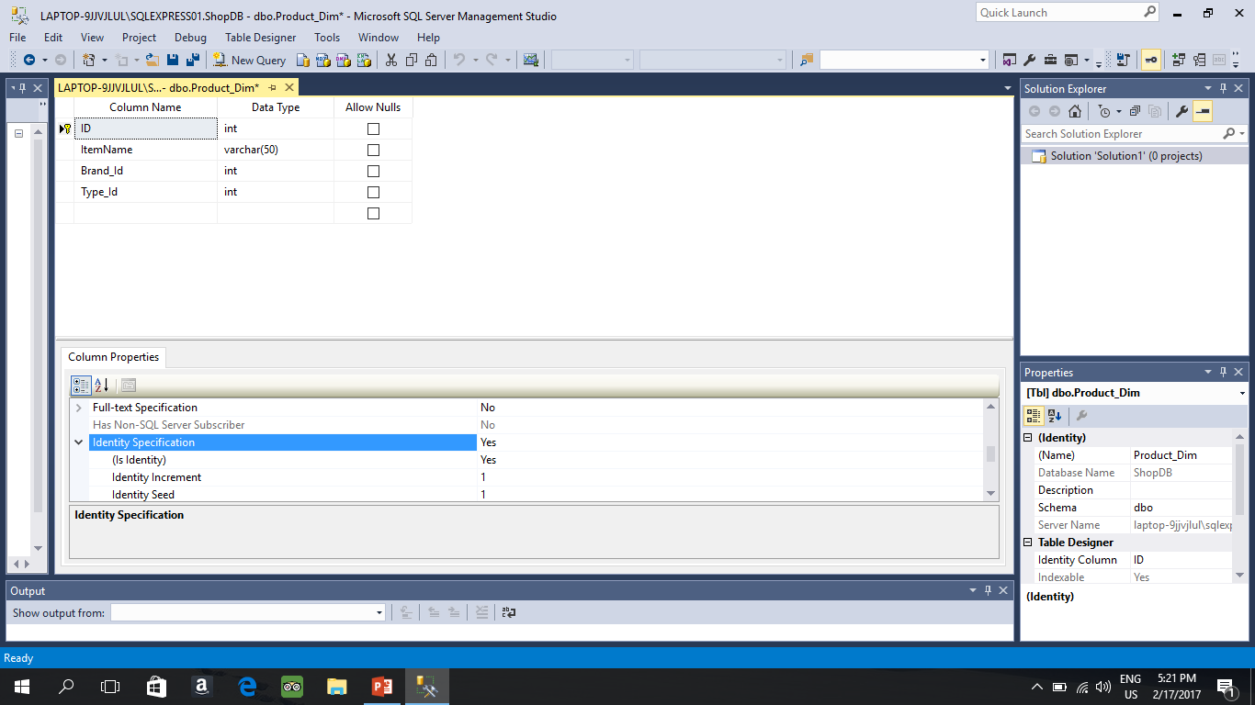
Making the key auto increment it self for every entry click on the primary key and then go down in box

Slide 14
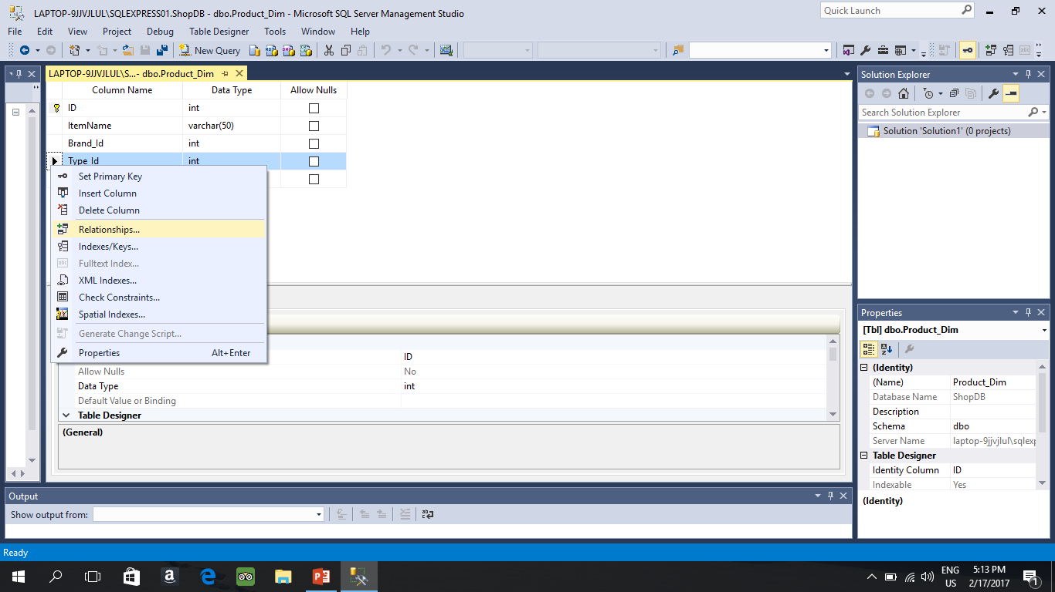
Creating a foreign Key
Open the Table that contains the column that you want to assign as Foreign Then

Slide 15
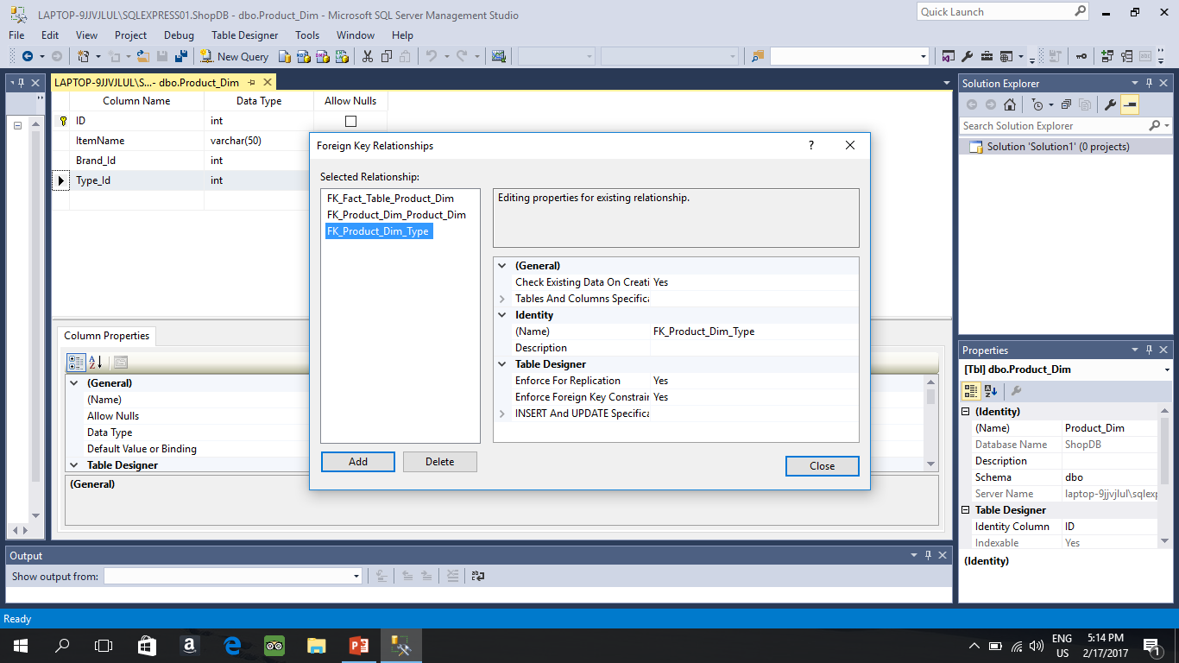
Cont. in you case the list will be empty press then click on Tables and column Specifics
2
1

Slide 16
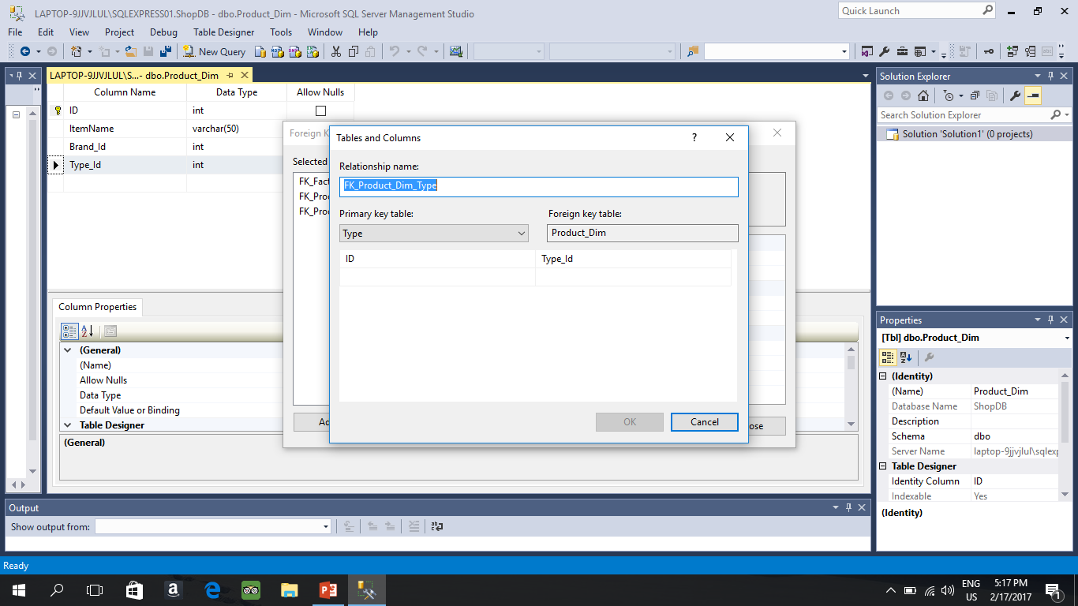
Cont Primary key table the table that you want to link with

Slide 17
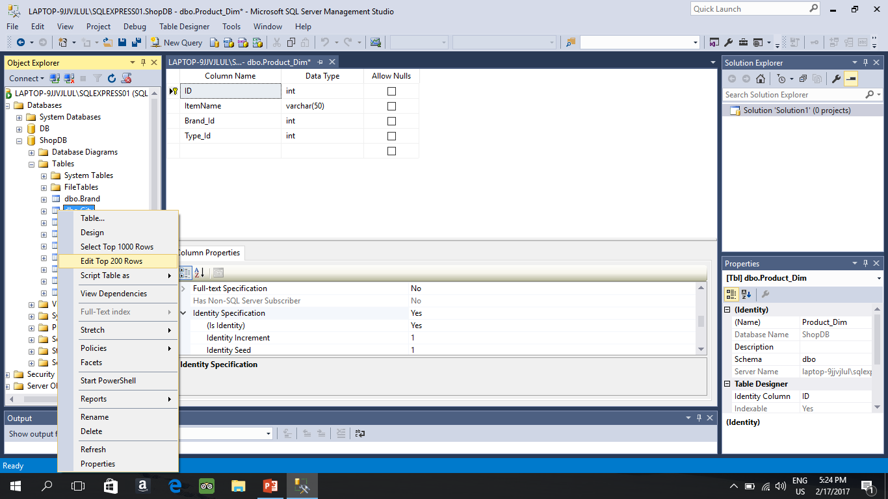
How to add records in the table: go to table you want to add then right click

Slide 18
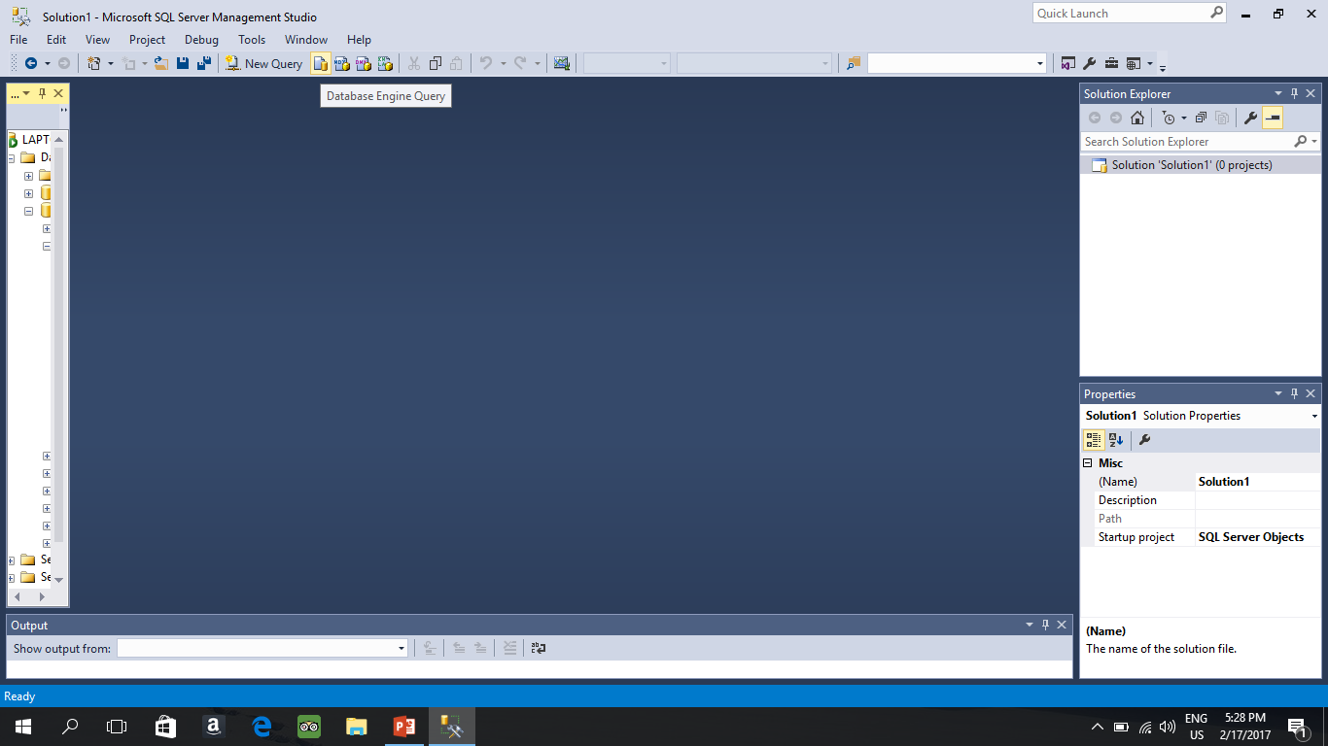
Regarding SQL Query
Since the project asks you to implements Roll-up , Drill down and Slice as query , Click on Daatabase Engine query

